Slide 1
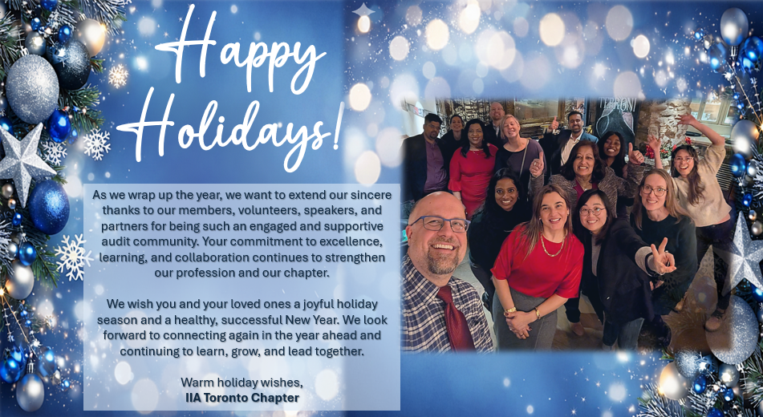
Notes:
LinkedIn & Social

Slide 2
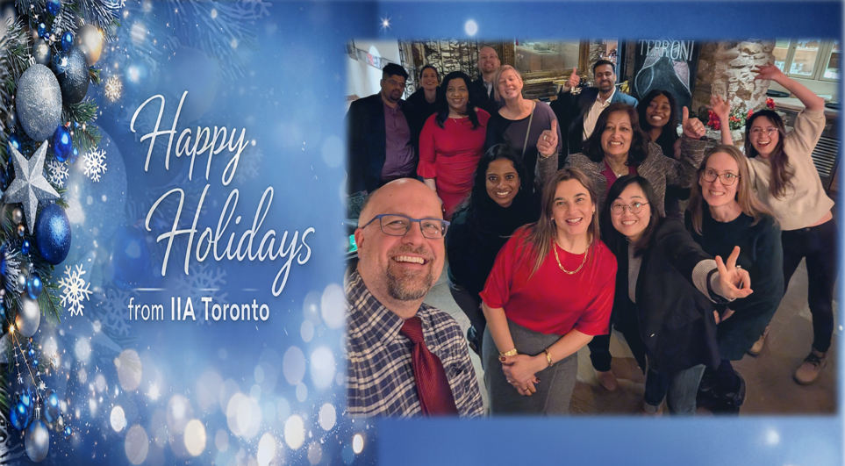
Notes:
Email Blast

Slide 3

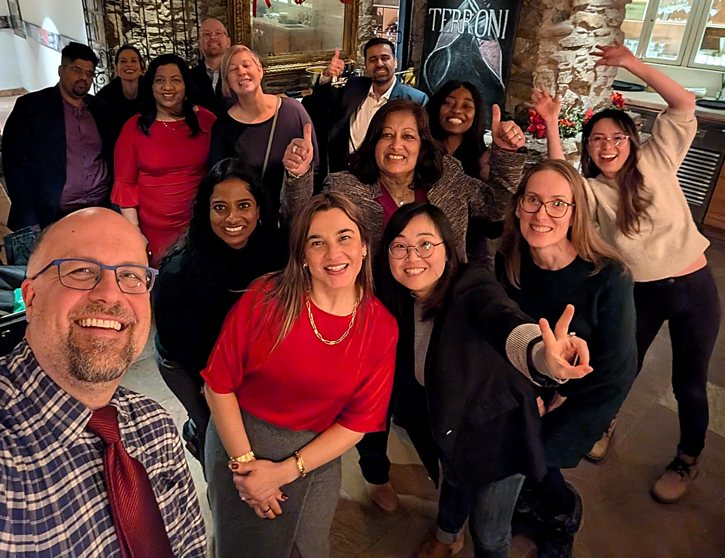
Happy
Holidays!
As we wrap up the year, we want to extend our sincere thanks to our members, volunteers, speakers, and partners for being such an engaged and supportive audit community. Your commitment to excellence, learning, and collaboration continues to strengthen our profession and our chapter.
We wish you and your loved ones a joyful holiday season and a healthy, successful New Year. We look forward to connecting again in the year ahead and continuing to learn, grow, and lead together.
Warm holiday wishes, IIA Toronto Chapter
Notes:
Linkedin + Social

Slide 4
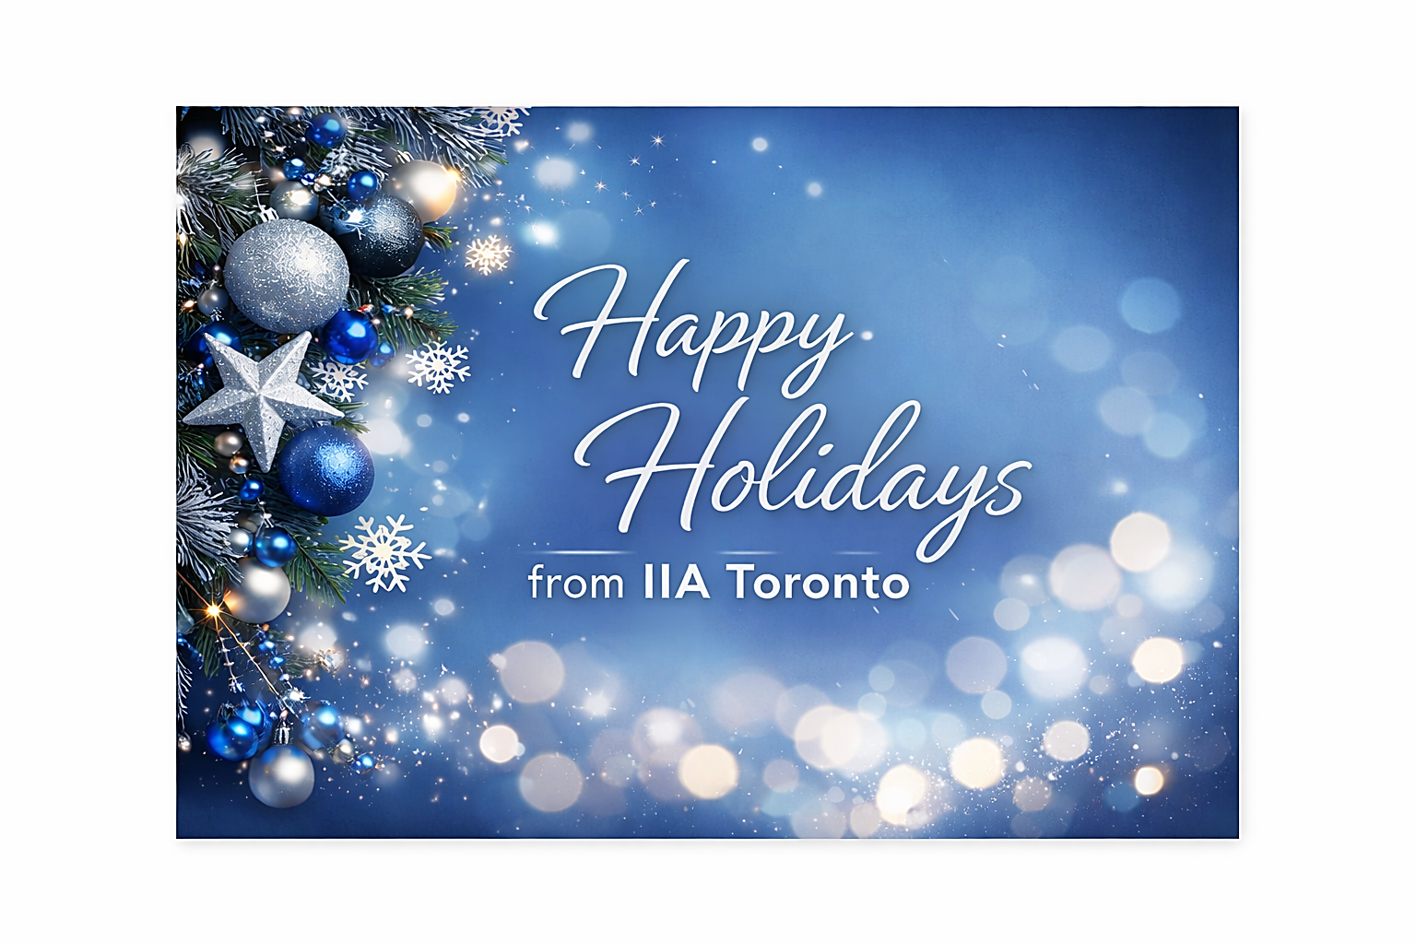

Notes:
Email Blast

