Slide 1
Internal Auditing The Profession of the Future

Slide 2
What’s Internal Auditing?
“Internal auditing is an independent, objective assurance and consulting activity designed to add value and improve an organization’s operations. It helps an organization accomplish its objectives by bringing a systematic, disciplined approach to evaluate and improve the effectiveness of risk management, control, and governance processes.”

Slide 3
Internal Auditing: One of the top five
in-demand professions throughout the world

Slide 4
Global Footprint
245,000+
Members
195,000+
CIA’s Awarded
170+
Countries & Territories
NORTH AMERICA
CENTRAL & SOUTH AMERICA
EUROPE
117
AFRICA
ASIA PACIFIC
Institutes Worldwide
MIDDLE EAST

Slide 5
Why Internal Auditing?
Internal Auditing is a valuable resource to an organization’s executive management, governing bodies (audit committees), and other stakeholders in helping them achieve their business goals and objectives, as well as strengthening internal control and governance.
The global demand for internal auditors today is unprecedented and is expected to increase annually as public and private companies and government entities continue to expand their audit needs in response to corporate reforms.

Slide 6
Why Organizations Need an Internal Audit Function?
Regardless of its size, every organization should have some type of internal control system/process to:
Reduce liability
Help control risks
Free-up management to focus on core mission
Improve the accuracy of financial and operational information
Offer a second opinion
Enhance service delivery
Improve financial results
Required in some countries
Not legally required in the U.S.
Exceptions: NYSE-listed corporations and a few specific industry/government requirements

Slide 7
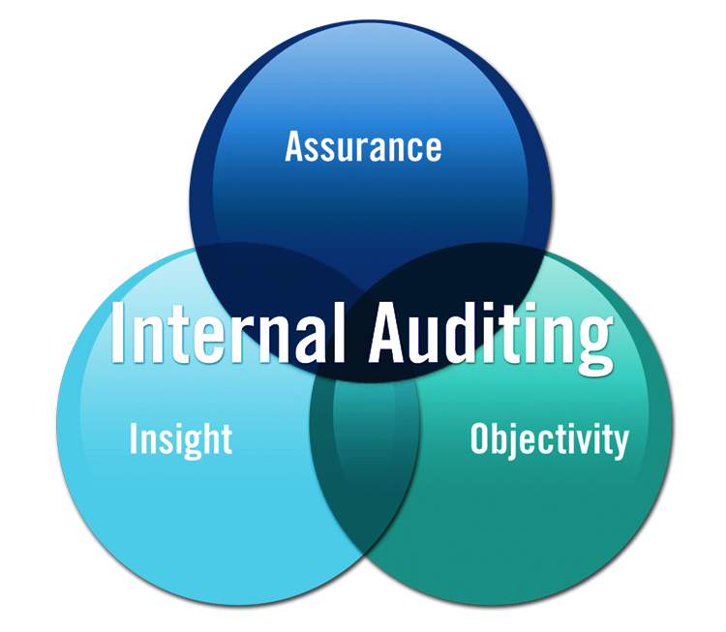
Internal Auditing = Assurance, Insight & Objectivity
Governing bodies and senior management rely on internal auditing for:
Objective assurance and insight on the effectiveness and efficiency of governance
Risk management
Internal control processes
Reference flyer

Slide 8
Internal Auditors Provide:
Assurance the organization is operating as management intends.
Insight for improving controls, processes, procedures, performance, and risk management; and for reducing expenses, enhancing revenues, and improving profits.
Objectivity in assessments of operations.

Slide 9
INTERNAL AUDITORS
Find out what’s working and what’s not
Keep an eye on the corporate climate
Look at the organization with fresh eyes
Look beyond the financial statements
Advocate improvements
Raise red flags
Tell it like it is

Slide 10
Internal Auditing: Organizations are paying higher entry level salaries, providing challenging and diversified projects, and offering more flexible schedules to entice future employees.

Slide 11
Internal Auditing: Current and future trends predict the profession will continue to grow through 2028.

Slide 12
Internal Auditing: Midpoint entry level salary in the United States is $80,000.
Source: Robert Half International Inc.

Slide 13
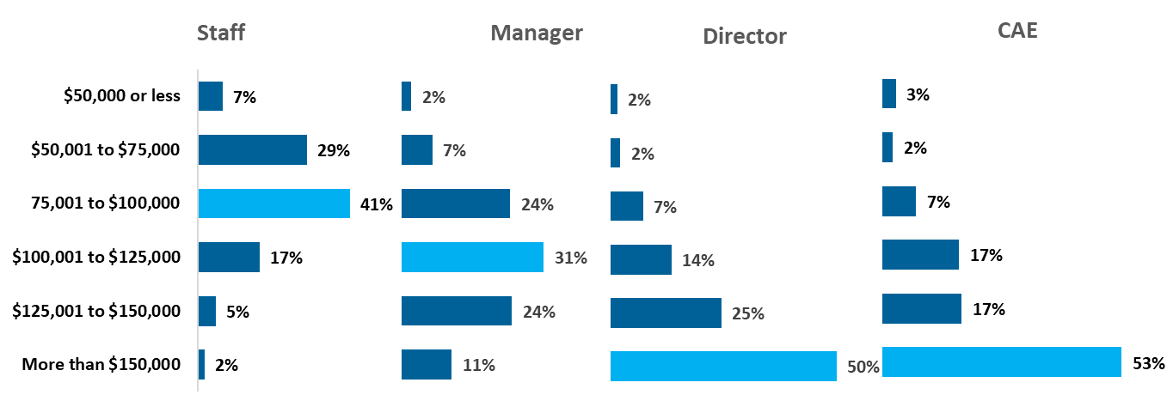
2023 North American Internal Audit Salaries
Source: North America IIA Member Satisfaction Survey, Sept/Oct 2023, n = 1,990.

Slide 14
Internal Auditors
Have variety of skills, educational backgrounds, and expertise.
Use their broad knowledge of the business to help management achieve business objectives and assist the governing body in fulfilling its oversight responsibility.
Are catalysts, risk, and control experts, efficiency specialists, and problem-solvers.

Slide 15
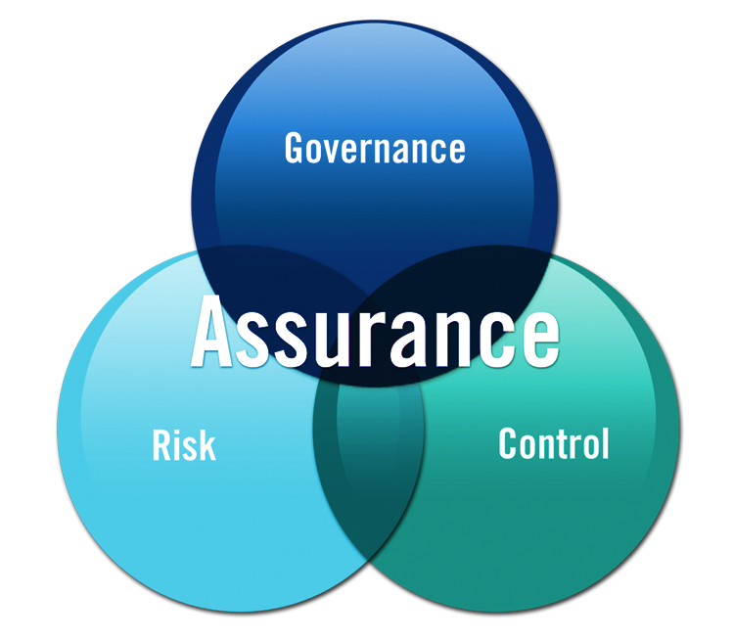
Assurance = Governance, Risk & Control
Internal auditing provides assurance on the organization’s governance, risk management, and control processes to help the organization achieve the following objectives:
Strategic
Operational
Financial
Compliance

Slide 16
Internal Auditing: With the explosive growth of the profession during the last decade, more and more colleges and universities offer internal auditing courses.

Slide 17
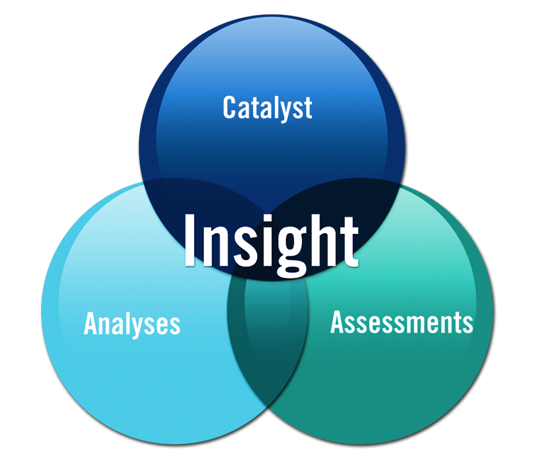
Insight = Catalyst, Analyses, & Assessments
Internal auditing is a catalyst for improving an organization’s effectiveness and efficiency by providing insight and recommendations based on analyses and assessments of data and business process.

Slide 18
Internal Auditing: The Certified Internal Auditor (CIA) —is the only globally accepted certification for the profession.

Slide 19
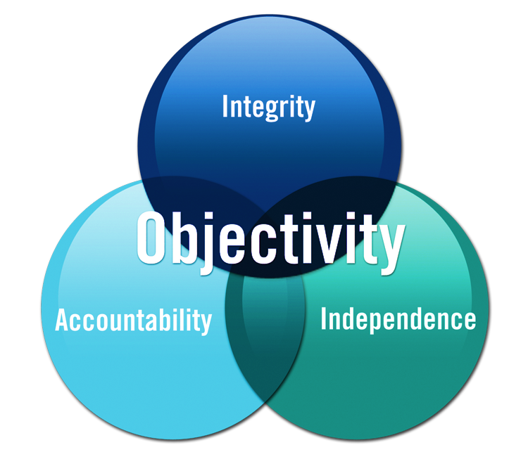
Objectivity = Integrity, Accountability & Independence
With commitment to integrity and accountability, internal auditing provides value to governing bodies and senior management as an objective source of independent advice.

Slide 20
Internal Auditing: Internal auditors are often chosen for promotion to management-level positions over their peers because of their unique organizational understanding and credibility.

Slide 21
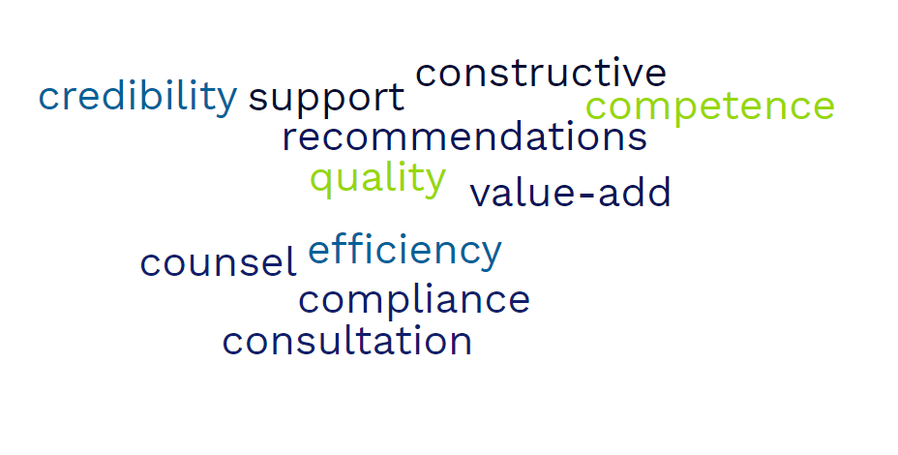
Internal Auditing is a Global Profession
Because internal auditing is a global profession, these alternate values may be considered in the intersecting circles to accommodate language translation.

Slide 22
Internal Auditing: Many internal auditors can write their own ticket when it comes to business travel.
Benefits:
Travel
Quality of life
Different areas to audit
Access to management & information
Any field and/industry
Public or Private

Slide 23
Five Critical Tasks
Determine whether controls are adequate
Suggest improvements to increase efficiency and effectiveness or to lower operating costs
Determine whether policies and procedures are followed
Determine whether laws and regulations are being obeyed
Detect fraud or manipulation of records

Slide 24
Internal Auditors Assess Risk…
To help management understand
Where their risks are
Whether the risks are under control
Whether the risks are worth taking
Evaluate organizational controls to manage risks
Are controls in place?
Do the controls work?
Are additional controls needed?
Are there unnecessary controls?
Are the controls cost-effective?

Slide 25
Internal Auditors are Influencers…
Keep senior management aware of critical issues
Ensure factual communications of financial, operational and compliance data
Make suggestions based on knowledge of operations throughout the organization

Slide 26
Internal Auditors’ Possible Stakeholders
Key Stakeholders
Audit committee/board
CEO
Secondary Stakeholders
Other business unit executives
External auditors and regulators
Investors and creditors
Tertiary Stakeholders
CFO or individual to whom CAE reports administratively
Potentially, other chief officers
(Government audit) citizens and taxpayers
Employees and retirees
Investment analysts
Potentially, the general public

Slide 27
Internal Auditing: Belonging to The IIA expands your knowledge of internal audit, fuels your professional ambitions, and champions limitless opportunity.

Slide 28
Internal Auditing: One of the ways to find out more about internal auditing is to join your local IIA chapter.

Slide 29
Why The IIA?
Belonging
Chapter Affiliation: Connect with local internal auditors at chapter events
Get Global: Meet students and professionals from around the world
I Am Blog: Get a feel for the wide range of individuals thriving in the profession
Fuel your professional ambitions
Mentorship Program: Students can apply to be paired with a profession mentor beginning Fall 2023
IIA Audit Career Center: Get access to resources to help fuel your career
Student Membership Discount on the CIA: Get certified on a budget
Champion limitless opportunity
Grants & Awards: Receive money from The IIA, the dissertation grant, and chapter scholarships to invest in your future
Free Member Webinars: Learn from profession leaders alongside practicing internal auditors
The IA Magazine: Read about current and future trends in the profession
Join Today!

Slide 30
Questions?
www.theiia.org

Slide 31
High Level Comparison: Internal vs. Financial Statement Audit
Internal Audit
Broad focus
Accurate financials
Efficiency/effectiveness
Accomplishing objectives
Compliance with laws, policy
Safeguarding assets
And more!
Diverse skill sets are required
Integral part of the organization
Financial Statement Audit
Specific focus
Accurate financial statements
Going concern
Reviewing historical data
Compliance with accounting and other regulations
Primarily accounting skills
Independent from the organization

Slide 32
Effective Governance

Slide 33
Maintaining Independence: Dual Reporting Relationships
About 80 percent of Chief Audit Executives (CAEs) report functionally to the Audit Committee/Board of Directors
Independent from audit activities
Wide authority
Most common administrative reporting relationship is to the President/CEO

Slide 34
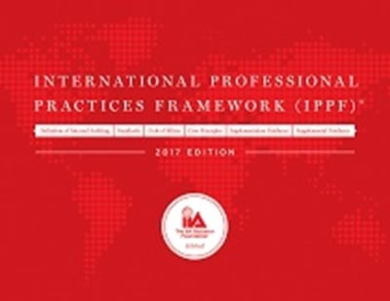
International Professional Practices Framework
Mandatory Guidance
International Standards for the Professional Practice of Internal Auditing
Definition of Internal Auditing
Code of Ethics
Strongly Recommended
Position Papers
Practice Advisories
Practice Guides
www.theiia.org

